Slide 1
Sustainable Energy Action Plans as Local Economy Drivers in Bosnia and Herzegovina
Petar M. Gvero, Ph.D.
Associate Professor
Association of Local Authorities of Republic of Srpska
Bratislava, September, 2011.

Slide 2
Introduction
Bosnia and Herzegovina have significant physical potential regard ig to re new able energy sources. Hydro, biomass, geother mal, wind, and solar potential can play important role in the whole state economy.
Bosnia and Herzegovina is Non-Annex I country according to UNFCCC and according to that it is obligated to participate in the global efforts in order to re duce green house gases emission.
Bosnia and Herzegovina uses twice as much energy to produce USD 1000 of GDP than the world average. Such high energy intensity is not a result of low efficiency in the conversion of primary forms of energy into secondary, but the result of low efficiency of transforming energy into products and quality of life.
Energy efficiency, from the consumption side is particular interest of the local authorities.
According to previous analysis energy intensity in Republic of Srspka is 4 times higher comaring to EU27 countries, and 2.5 higher than World’s average.

Slide 3
Green Economy
Environmentally sustainable, based on the belief that our biosphere is a closed system with finite resources and a limited capacity for self-regulation and self-renewal.
Socially just, based on the belief that culture and human dignity are precious resources that, like our natural resources, require responsible stewardship to avoid their depletion.
Locally rooted, based on the belief that an authentic connection to place is the essential pre-condition to sustainability and justice. The Green Economy is a global aggregate of individual communities meeting the needs of its citizens through the responsible, local production and exchange of goods and services.
Source: Wikipedia

Slide 4
Renewable Energy Sources and Energy Efficiency and use of their potential is the obviously key issue in a transition to green economy.

Slide 5
Macro-project: Demand-Side Energy Efficiency
B&H’s Initial National Communication according to UNFCCC

Slide 6
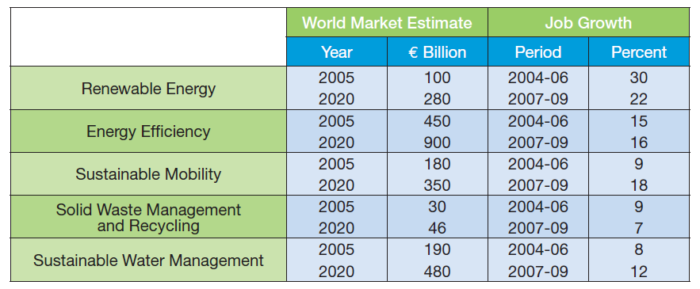
Employment
Germany: The number of jobs related to RES increased from 56.600 in 1998. to 250.000 u 2007. and 278.000 u 2008. Some projections said that Germany can have around 400.000 to 500.000 employee in this sector, until 2020.
Only building sector (EE) can create 2.58 million of jobs until 2030 in EU.
Izvor:Low Carbon Jobs for Europe

Slide 7
Employment
Official rate of unemployment in Bosnia and Herzegovina is extremely high and it was 41,8% in 2009 - u FBiH 44,9% and RS 35,5%.
Source: Bosnia and Herzegovina Economical Trends, Yearly report, 2009

Slide 8
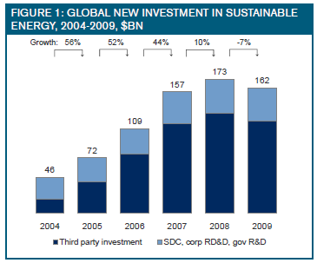
Investicije
Investments in green energy technologies in the following ten years will exceed 2 trillion USD, particularly teking in to consideration European government mandate to produce 20% of energy from the renewable energy sources, until 2020. , while USA reduces taxes for 100%, for the investments in RES in 2011.
Source: UNEP, 2011
Source: Nova Capital Partners, LLC

Slide 9
Investments
Rough estimation made by the Ministry of Industry, Energy and Mining of Republic of Srpska shows:
Building sector – it is necessary to energy improve 137,000 flats and buildings, or 12.25 million of m2, that means over 500 million Euro of the investments.
DHS Sector – potential investments arround 250 million of Euro, etc.

Slide 10
Covenant of Mayors
The Covenant of Mayors is the mainstream European movement involving local and regional authorities, voluntarily committing to increasing energy efficiency and use of renewable energy sources on their territories.
By their commitment, Covenant signatories aim to meet and exceed the European Union 20% CO₂ reduction objective by 2020.
http://www.eumayors.eu/index_en.html

Slide 11
Sustainable Energy Action Plan (SEAP)
A Sustainable Energy Action Plan (SEAP) is the key document in which the Covenant signatory outlines how it intends to reach its CO2 reduction target by 2020.
It defines the activities and measures set up to achieve the targets, together with time frames and assigned responsibilities.
Covenant signatories are free to choose the format of their SEAP, as long as it is in line with the general principles set out in the Covenant SEAPguidelines.

Slide 12
Covenant of Mayors Signatories from Bosnia and Herzegovina
Signatories | Population | Adhesion
Banja Luka, RS | 250,000 | 30 Jan 2009
Bihac, FB&H |  | 17 Dec 2010
Bijeljina, RS | 130,000 | 21 Oct 2010
Gradiška, RS | 62,000 | 14 Apr 2011
Kakanj, FB&H | 46,500 | 8 Dec 2010
Laktasi, RS | 40,000 | 18 Mar 2011
Livno, FB&H | 40,600 | 30 Mar 2011
Prijedor, RS | 105,000 | 1 Nov 2010
Sarajevo, FB&H | 300,000 | 10 Mar 2009
Travnik, FB&H | 55,000 | 15 Mar 2011
Trebinje, RS | 36,000 | 30 Dec 2010
Tuzla, FB&H | 174,000 | 3 Feb 2010
Zenica, FB&H | 127,000 | 29 Dec 2010

Slide 13
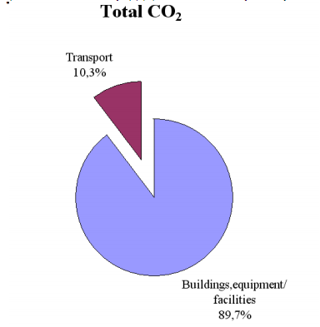
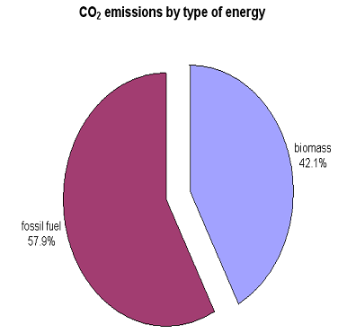
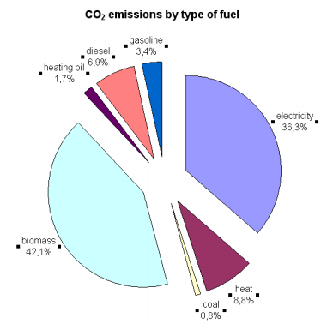
Banja Luka SEAP example – base year CO2 emission inventory

Slide 14
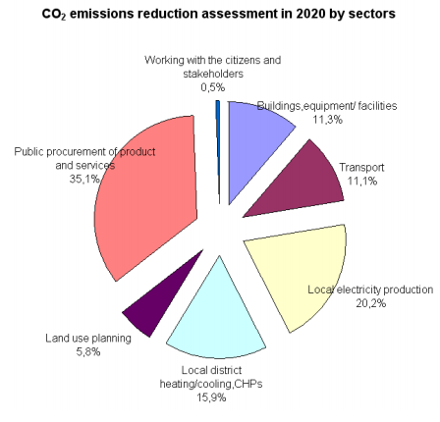
Banja Luka SEAP example

Slide 15
Motivation of the local community for the SEAP project realization
Definition of the reasons for the projects realization (energy consumption increase, prices of energy, pollutant emission increase, etc.).
Targets (cost reduction, services quality improvement, air quality improvement, etc.).
Feasibility (economical, technical, market, sensitivity, etc.).
Financing (own sources, own credits, private money, ESCO, etc.).

Slide 16
The experience based issues, important for the successful SEAP implementation
The experience of working in project groups across departmental lines –problems in vertical and horizontal communication beetwen the stakeholders.
Seeing the usefulness in cooperation with the private sector/private companies in PPP (Public-Private-Partnerships).
Larger understanding of what will attract investors.
Larger understanding of and experience in communicating with the citizens.
Experience in formulating and evaluating municipal investment projects.

Slide 17
Success example – Ireland
When Ireland became a member of EU in 1972 (together with Denmark and UK), they were the poorest country of the 9 member states (Germany, France, Italy, Netherlands, Belgium, Luxembourg, Denmark, UK and Ireland).
They went from the bottom to be in the Top 5 economies in the EU before the financial crisis which hit Ireland very hard.
When they became a member of the EU, they knew that they would be entitled to a lot of assistance from the EU development programs.
Contrary to in Portugal and Greece where such assistance funds were used quite randomly, in Ireland they set their goals for economic and business development – and they made a strategic plan.
Then they committed a lot of their own funds for this, and whenever EU funds became available, they were steered directly into the activities to fulfill their strategic plan.
EU and private investors were happy because they could see a clear direction and purpose of the investments and they could also see the commitment because Ireland provided a lot of money from their own budget for this purpose.

Slide 18
THANK YOU VERY MUCH
petargvero@yahoo.com

